Slide 1

INTERNET MULTICASTING

Slide 2
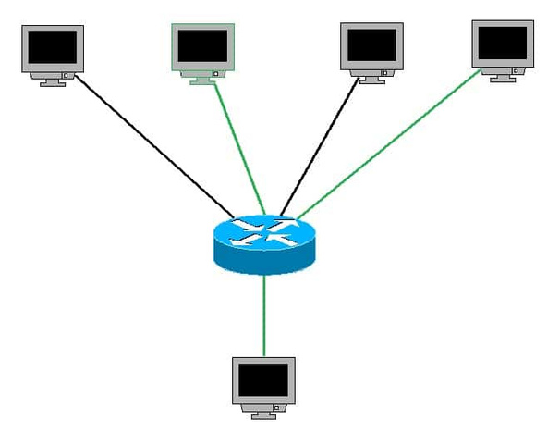

Multicasting refers to a method in computer networking where a single source sends data to multiple recipients on a network simultaneously.
It supports one – to – many and many – to – many data transmission across LANs or WANs. Through the process of multicasting, the communication and processing overhead of sending the same data packet or data frame in minimized.
WHAT IS MULTICASTING?

Slide 3
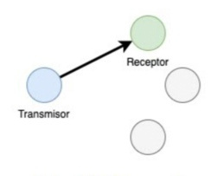
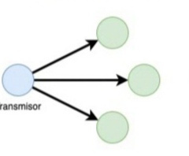
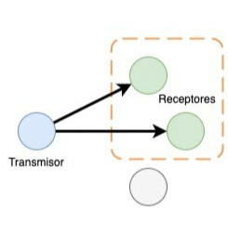

MULTICAST VS. UNICAST AND BROADCAST
UNICAST
BROADCAST
MULTICAST
sending data from one source to multiple receivers at the same time
one-to-one transmission of data packets over a network,
sends data from a single source to all devices within the network's range

Slide 4
Key Elements :
HOW MULTICASTING WORKS?
Source: The sender that transmits the data.
Multicast Group: A group of devices (receivers) that subscribe to the multicast.
Multicast Address: A unique IP address that identifies a multicast group (e.g., Class D IP addresses: 224.0.0.0 to 239.255.255.255).
Multicast Router:Multicast Router is a networking device responsible for managing and directing multicast traffic efficiently from the source to destination
Internet Group Management Protocol (IGMP): Used to manage host group membership

Slide 5
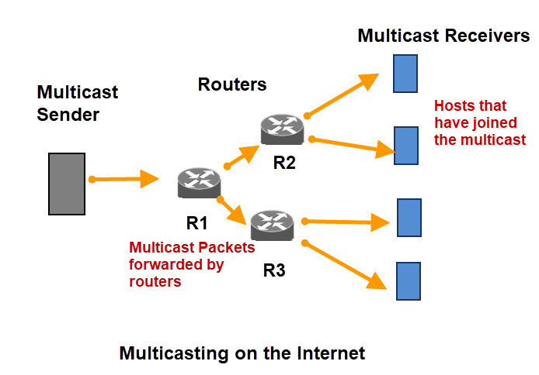

Slide 6
APPLICATIONS
Live Video Streaming & Broadcasting:Multicasting is ideal for streaming live events like sports matches, news broadcasts, webinars, or concerts to large audiences.
Software Distribution & Updates:Companies and IT departments use multicasting to distribute software updates or patches to multiple devices in a network
Distance Learning & Virtual Classrooms:Educational institutions can use multicasting to deliver lectures, seminars, and course materials to students across different locations.
Military & Defense Communications:The military uses multicasting for mission-critical communications, such as distributing real-time battlefield data or command orders to multiple units in different locations.

Slide 7
Thank you

